Slide 1
UBND HUYỆN TRÀ BỒNG
TRƯỜNG TH TRÀ XUÂN
English 3
Teacher : Nguyen Thi Bich Ly

Slide 2



WELCOME TO OUR CLASS
Class : 3D
Tra Xuan Primary School

Slide 3


Slide 4


Slide 5


Slide 6
Monday,December 19th 2022
UNIT 10: BREAK TIME ACTIVITIES
Lesson 1 (Part 1,2,3)

Slide 7
*Vocabulary :
-Break time :
giờ giải lao (ra chơi)
- Chess :
cờ vua
-Volleyball :
bóng chuyền
-Basketball :
bóng rổ
-Badminton :
cầu lông

Slide 8
*Checking words:

Slide 9


Play game
Bus Stop

Slide 10


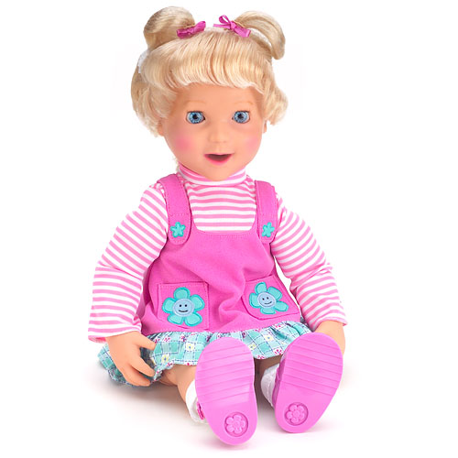

Check
homework
O L D L
DOLL
chess

Slide 11
Check
homework
O L D L
DOLL
basketball

Slide 12
Check
homework
O L D L
DOLL
badminton

Slide 13
Check
homework
O L D L
DOLL
volleyball

Slide 14
Check
homework
O L D L
DOLL
Break time

Slide 15


Slide 16

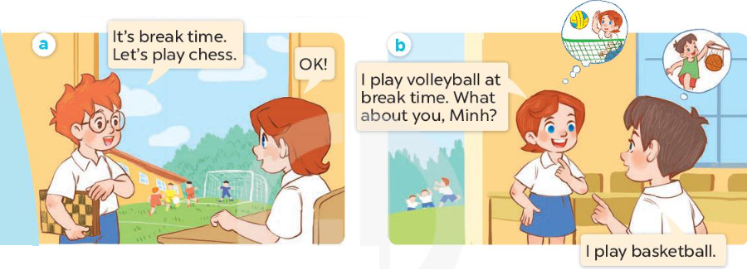
1/Look, listen and repeat

Slide 17
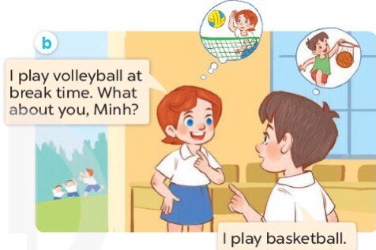
Model sentence :
Mẫu câu kể hoạt động của em trong giờ giải lao :
I ………… at break time.

Slide 18
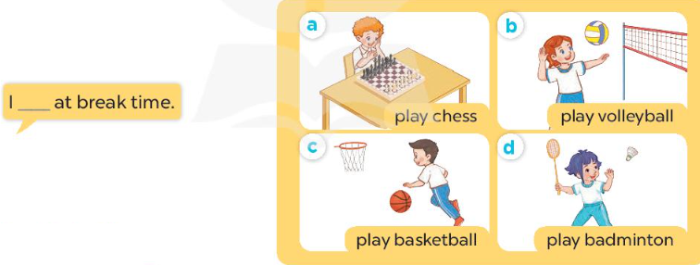
2/Listen, point and say

Slide 19
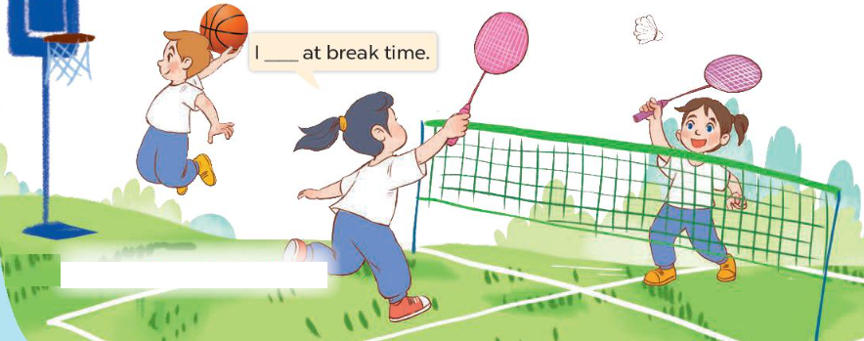
3/Let’s talk

Slide 20

3/Let’s talk

Slide 21
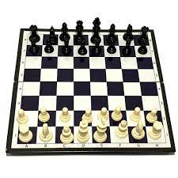


1.A I play volleyball at break time . .
1.B I play basketball at break time ..
1.C I play chess at break time ..

Slide 22

2.A I play volleyball at break time ..
2.B I play badminton at break time ..
2.C I play basketball at break time ..

Slide 23
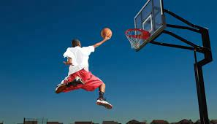
3.A I play badminton at break time ..
3.B I play basketball at break time ..
3.C I play chess at break time .

Slide 24

4. A I play volleyball at break time .
4. B I play basketball at break time .
4. C I play badminton at break time ..

Slide 25


Slide 26


