Slide 1

UBND HUYỆNTRÀ BỒNG
TRƯỜNG TIỂU HỌC TRÀ XUÂN
Welcome
to our English class
Teacher: Ms. Yen
Class: 1D

Slide 2

Let’s sing and dance

Slide 3
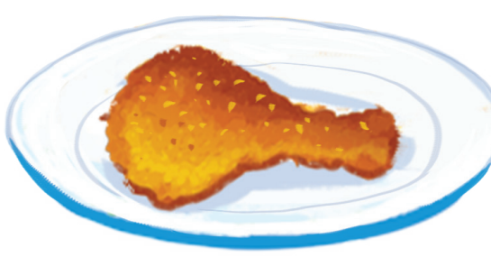
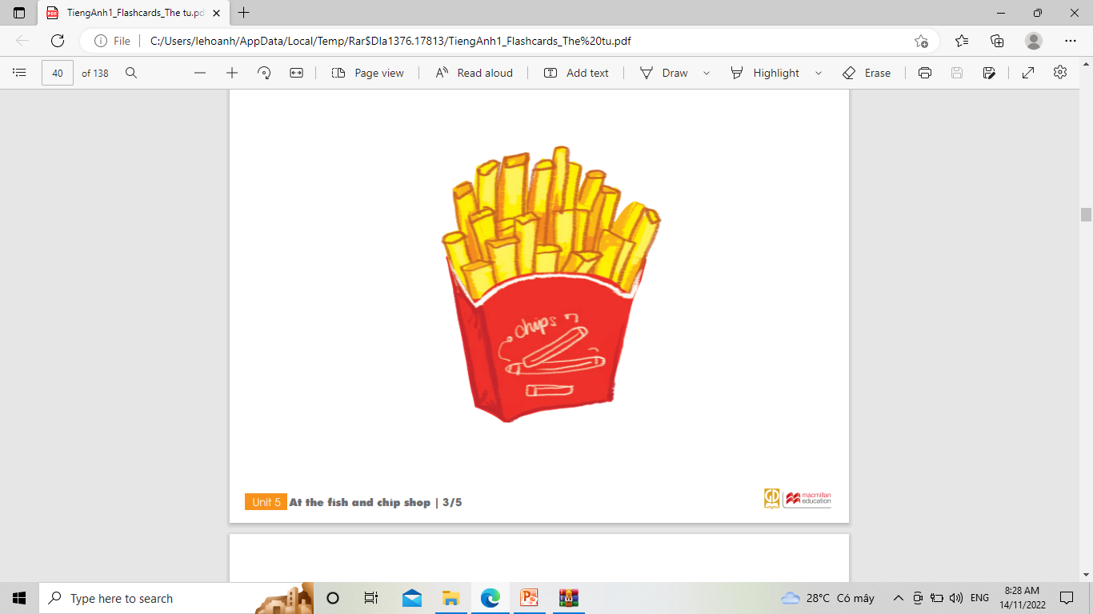
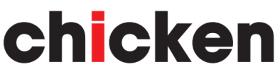
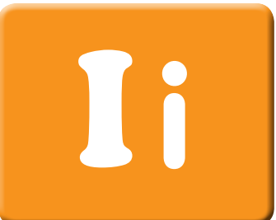
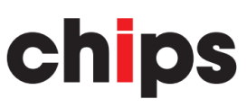
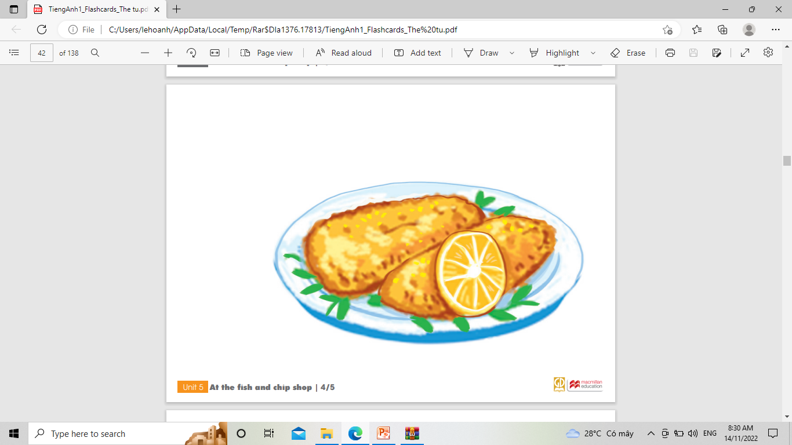
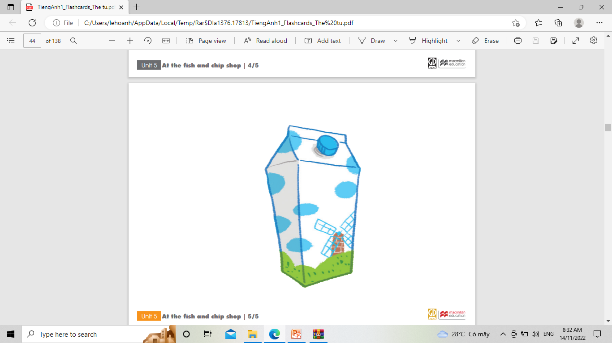
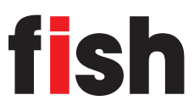
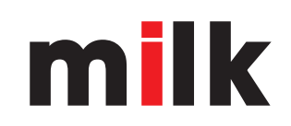

Slide 4
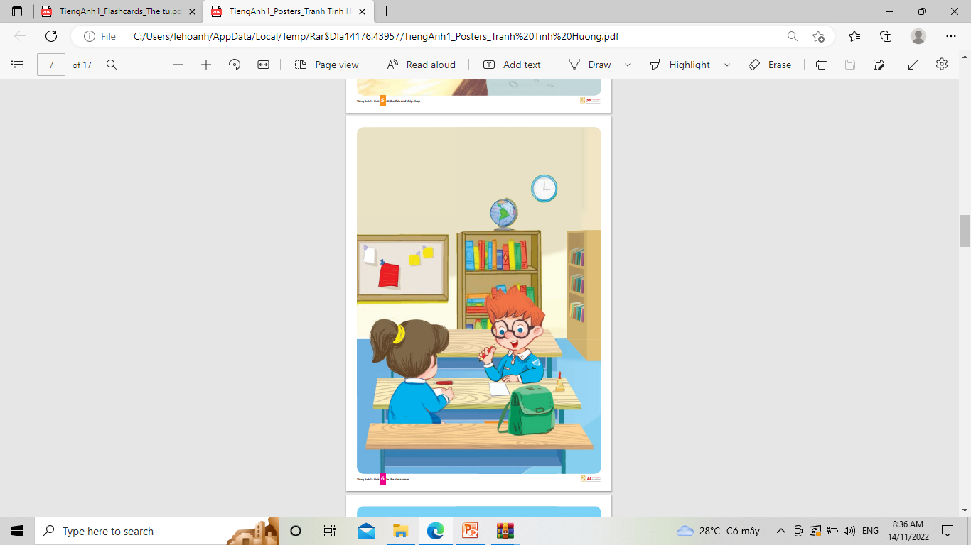
UNIT 6: IN THE CLASSROOM
Lesson 1

Slide 5

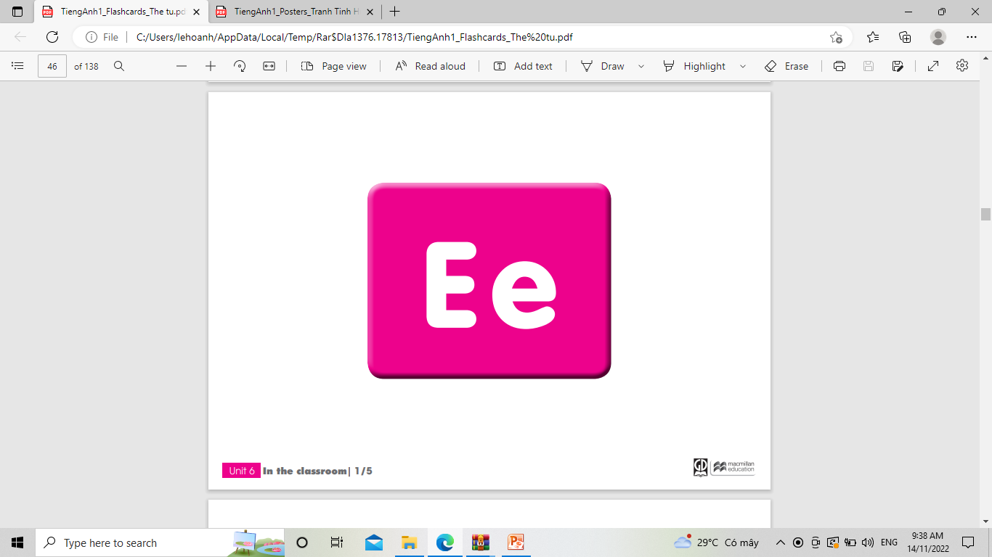
1. Listen and repeat

Slide 6
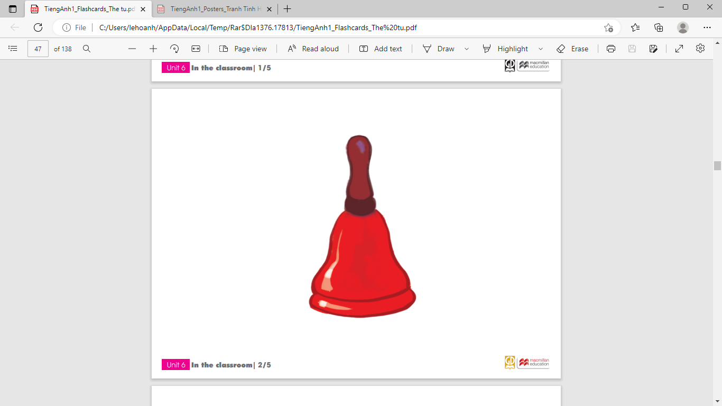
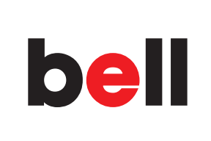

Slide 7
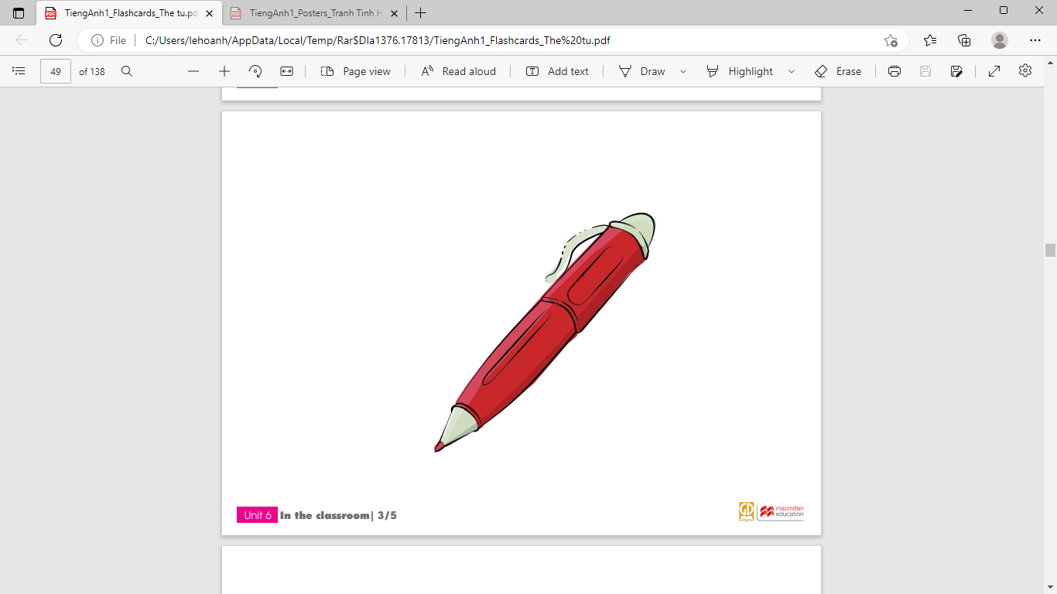
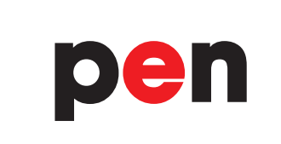

Slide 8
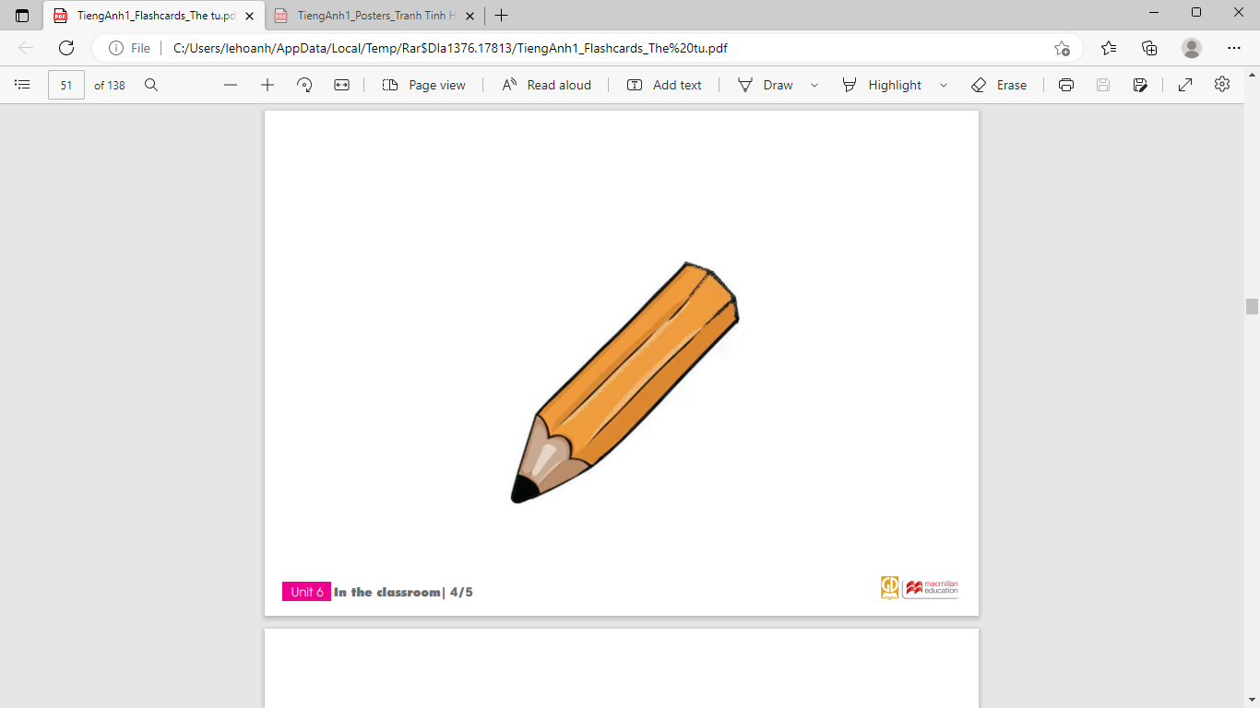
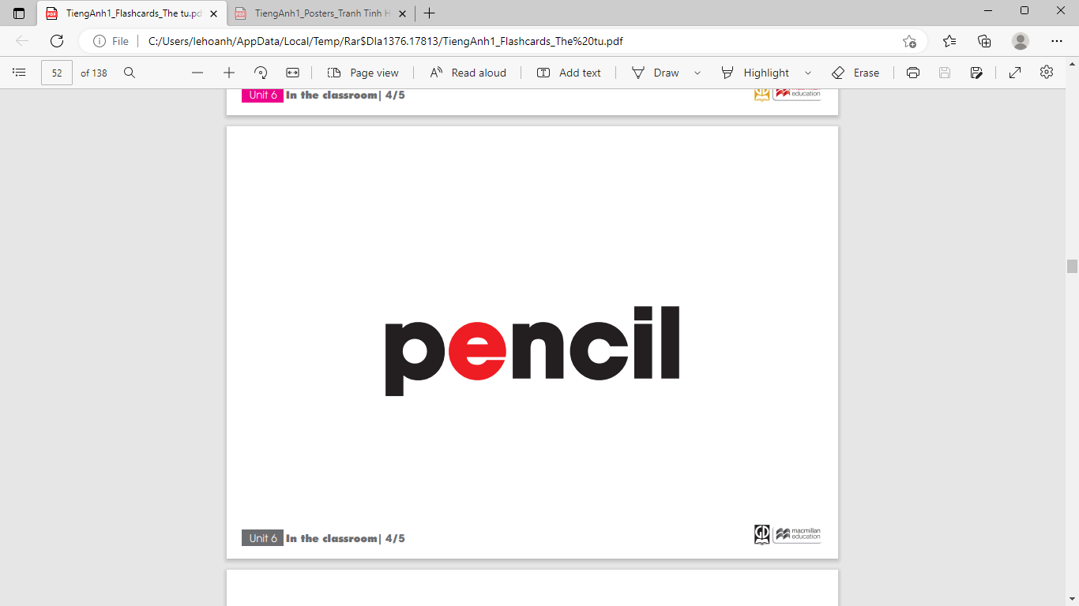

Slide 9
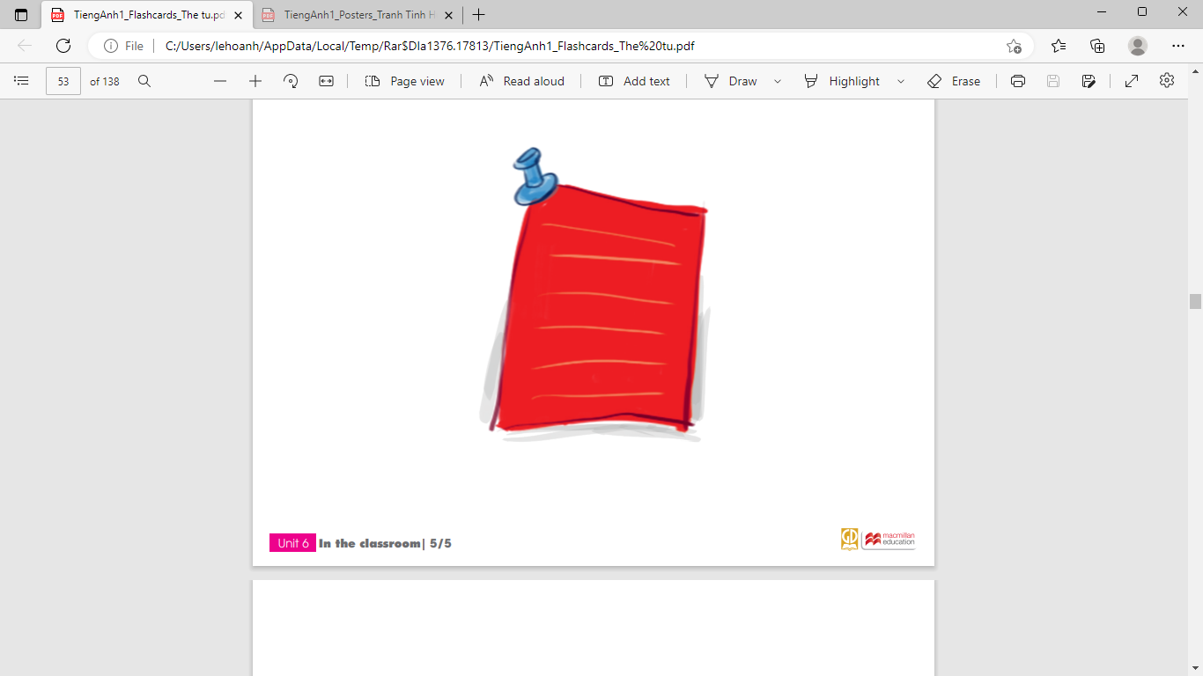
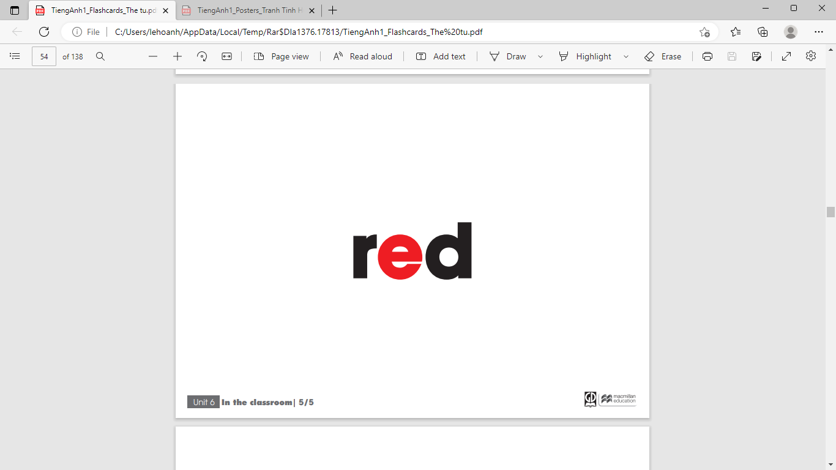

Slide 10
Checking words: Look and match
a
b
c
d

Slide 11
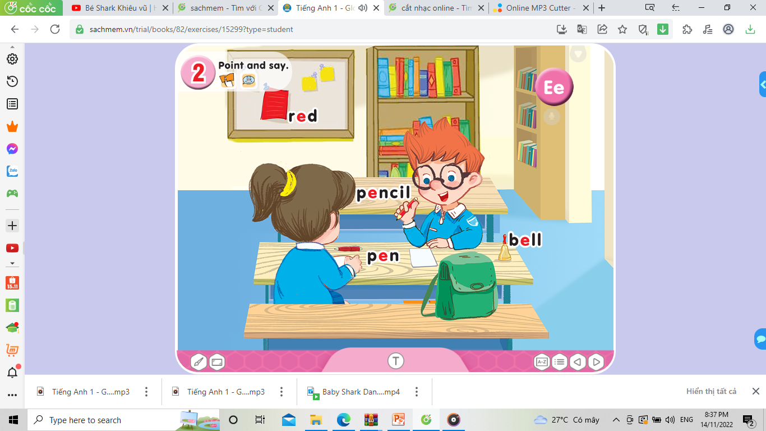

Slide 12
Play game: Slap the board

Slide 13
Homework
- Correctly identify and pronounce the words: E/e, bell, pen, pencil, red
- Prepare unit 6 – lesson 2
- Do exercise in the workbook

Slide 14


